Slide 1
STAT 221-FUNdamentals of STATISTICAL DATA ANALYSIS
Week-13: Hypothesis Testing
Shivakumar Jolad

Slide 2
Hypothesis testing

Slide 3
Distinctions Between Parameters and Statistics (Chapter 8 review)
 | Parameters | Statistics
Source | Population | Sample
Notation | Greek (e.g., μ) | Roman (e.g., xbar)
Vary | No | Yes
Calculated | No | Yes
Notes:
Foundation of statistical inference: the difference between parameters and statistics. Parameters and statistics are related, but are not the same thing.

Slide 4
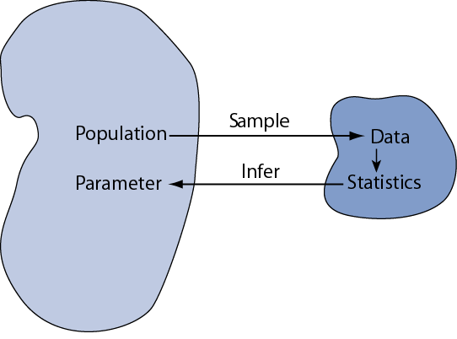

Slide 5
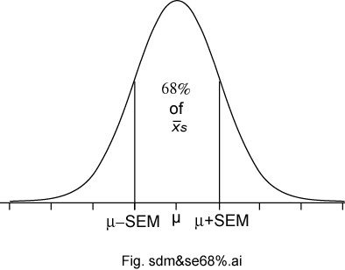
Sampling Distributions of a Mean (last Class)
The sampling distributions of a mean (SDM) describes the behavior of a sampling mean
Three important sampling postulates: the central limit theorem, the law of large numbers (unbiased nature of the sample mean), and square root law.
Notes:
This slide summarize what we’ve learned about the sampling distribution of a mean from a large sample. It is based no three important sampling postulates: the central limit theorem, the law of large numbers (unbiased nature of the sample mean), and square root law. Based on these well established statistical theorems we can say that means based on large samples (and means based in Normal populations) will have a Normal sampling distribution with an expectation equal to the population mean with a standard deviation equal to the standard deviation of the population divided by the square root of the sample size n.

Slide 6
Watch the videos

Slide 7

Basics (for your revision)
Understanding Statistical Inference: 6:30 mins
https://www.youtube.com/watch?v=tFRXsngz4UQ&list=PLm9FYjKtq7Pzjh7e727hSr8VvSR9OvqsZ

Slide 8

P-value
Understanding p-value (4:30 mins)
https://www.youtube.com/watch?v=eyknGvncKLw&list=PLm9FYjKtq7Pzjh7e727hSr8VvSR9OvqsZ&index=2

Slide 9

Hypothesis Testing (7:30 mins): https://www.youtube.com/watch?v=0zZYBALbZgg&list=PLm9FYjKtq7Pzjh7e727hSr8VvSR9OvqsZ&index=3

Slide 10
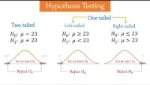
Hypothesis testing (4 mins): https://www.youtube.com/watch?v=DlwOTOydeyk

Slide 11
Hypothesis Testing
Is also called significance testing
Tests a claim about a parameter using evidence (data in a sample)
The technique is introduced by considering a one-sample z test
Procedure:
Null and alternative hypotheses
Test statistic
P-value and interpretation
Significance level (optional)
Notes:
Hypothesis testing (also called significance testing) uses a quasi-deductive procedure to judge claims about parameters. Before testing a statistical hypothesis it is important to clearly state the nature of the claim to be tested. We are then going to use a four step procedure (as outlined in the last bullet) to test the claim.

Slide 12
Null and Alternative Hypotheses
Convert the research question to null and alternative hypotheses
The null hypothesis (H₀) is a claim of “no difference in the population”
The alternative hypothesis (H_{a}) claims “H₀ is false”
Collect data and seek evidence against H₀ as a way of bolstering H_{a} (deduction)
Notes:
The first step in the procedure is to state the hypotheses null and alternative forms. The null hypothesis (abbreviate “H naught”) is a statement of no difference. The alternative hypothesis (“H sub a”) is a statement of difference. Seek evidence against the claim of H₀ as a way of bolstering H_{a.}
The next slide offers an illustrative example on setting up the hypotheses.

Slide 13
Illustrative Example: “Body Weight”
The problem: In the 1970s, 20–29 year old men in the U.S. had a mean μ body weight of 170 pounds. Standard deviation σ was 40 pounds. We test whether mean body weight in the population now differs.
Null hypothesis H_{0:} μ = 170 (“no difference”)
The alternative hypothesis can be either H_{a:} μ > 170 (one-sided test) or H_{a:} μ ≠ 170 (two-sided test)
Notes:
In the late 1970s, the weight of U.S. men between 20- and 29-years of age had a log-normal distribution with a mean of 170 pounds and standard deviation of 40 pounds. As you know, the overweight and obese conditions seems to be more prevalent today, constituting a major public health problem. To illustrate the hypothesis testing procedure, we ask if body weight in this group has increased since 1970. Under the null hypothesis there is no difference in the mean body weight between then and now, in which case μ would still equal 170 pounds.
Under the alternative hypothesis, the mean weight has increased Therefore, H_{a:} μ > 170. This statement of the alternative hypothesis is one-sided. That is, it looks only for values larger than stated under the null hypothesis.
There is another way to state the alternative hypothesis. We could state it in a “two-sided” manner, looking for values that are either higher- or lower-than expected. For the current illustrative example, the two-sided alternative is H_{a:} μ ≠ 170. Although for the current illustrative example, this seems unnecessary, two-sided alternative offers several advantages and are much more common in practice.

Slide 14
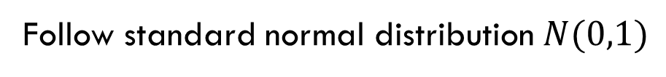
Test Statistic
This is an example of a one-sample test of a mean when σ is known. Use this statistic to test the problem:
Follow standard normal distribution $N(0,1)$

Slide 15
Illustrative Example: z statistic
For the illustrative example, μ₀ = 170
We know σ = 40
Take an SRS of n = 64. Therefore
If we found a sample mean of 173, then

Slide 16
Illustrative Example: z statistic
If we found a sample mean of 185, then

Slide 17
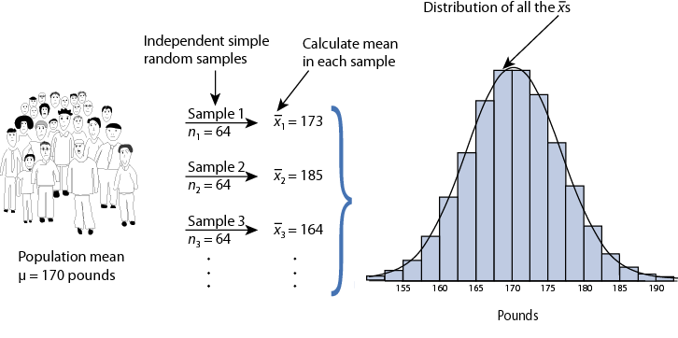
Reasoning BehinD z_{stat}
Sampling distribution of xbar under H₀: µ = 170 for n = 64 ⇒

Slide 18
P-value
The P-value answer the question: What is the probability of the observed test statistic or one more extreme when H₀ is true?
This corresponds to the AUC in the tail of the Standard Normal distribution beyond the z_{stat.}
Convert z statistics to P-value :
For H_{a}: μ > μ₀ ⇒ P = Pr(Z > z_{stat}) = right-tail beyond z_{stat}
For H_{a}: μ < μ₀ ⇒ P = Pr(Z < z_{stat}) = left tail beyond z_{stat}
For H_{a}: μ ≠ μ₀ ⇒ P = 2 × one-tailed P-value
Use Tables or software to find these probabilities (next two slides).

Slide 19
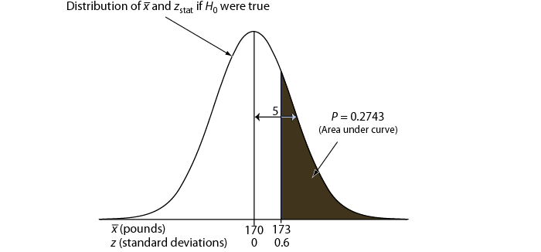
One-sided P-value for z_{stat} of 0.6

Slide 20
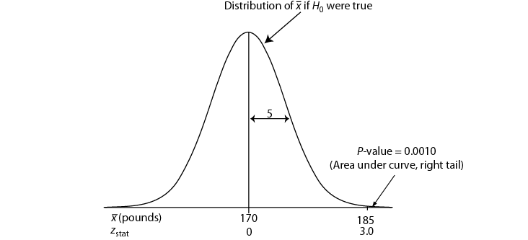
One-sided P-value for z_{stat} of 3.0

Slide 21
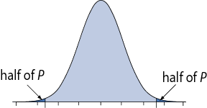
Two-Sided P-Value
One-sided H_{a} ⇒ AUC in tail beyond z_{stat}
Two-sided H_{a} ⇒ consider potential deviations in both directions ⇒ double the one-sided P-value
Examples: If one-sided P = 0.0010, then two-sided P = 2 × 0.0010 = 0.0020. If one-sided P = 0.2743, then two-sided P = 2 × 0.2743 = 0.5486.

Slide 22
Interpretation
P-value answer the question: What is the probability of the observed test statistic … when H₀ is true?
Thus, smaller and smaller P-values provide stronger and stronger evidence against H₀
Small P-value ⇒ strong evidence

Slide 23
Interpretation
Conventions*
P > 0.10 ⇒ non-significant evidence against H₀
0.05 < P ≤ 0.10 ⇒ marginally significant evidence
0.01 < P ≤ 0.05 ⇒ significant evidence against H₀
P ≤ 0.01 ⇒ highly significant evidence against H₀
Examples
P =.27 ⇒ non-significant evidence against H₀
P =.01 ⇒ highly significant evidence against H₀
* It is unwise to draw firm borders for “significance”

Slide 24
α-Level (Used in some situations)
Let α ≡ probability of erroneously rejecting H₀
Set α threshold (e.g., let α = .10, .05, or whatever)
Reject H₀ when P ≤ α
Retain H₀ when P > α
Example: Set α = .10. Find P = 0.27 ⇒ retain H₀
Example: Set α = .01. Find P = .001 ⇒ reject H₀

Slide 25
(Summary) One-Sample z Test
Hypothesis statements H₀: µ = µ₀ vs. H_{a}: µ ≠ µ₀ (two-sided) or H_{a}: µ < µ₀ (left-sided) or H_{a}: µ > µ₀ (right-sided)
Test statistic
P-value: convert z_{stat} to P value
Significance statement (usually not necessary)

Slide 26
Conditions for z test
σ known (not from data)
Population approximately Normal or large sample (central limit theorem)
SRS (Simple random Sample or facsimile)
Data valid

Slide 27
The Lake Wobegon Example “where all the children are above average”
Let X represent Weschler Adult Intelligence scores (WAIS)
Typically, X ~ N(100, 15)
Take SRS of n = 9 from Lake Wobegon population
Data ⇒ {116, 128, 125, 119, 89, 99, 105, 116, 118}
Calculate: x-bar = 112.8
Does sample mean provide strong evidence that population mean μ > 100?

Slide 28
Example: “Lake Wobegon”
Hypotheses: H₀: µ = 100 versus H_{a}: µ > 100 (one-sided) H_{a}: µ ≠ 100 (two-sided)
Test statistic:

Slide 29
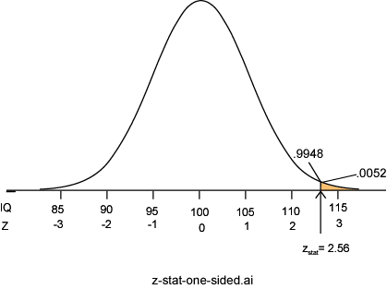
C. P-value: P = Pr(Z ≥ 2.56) = 0.0052
P =.0052 ⇒ it is unlikely the sample came from this null distribution ⇒ strong evidence against H₀

Slide 30
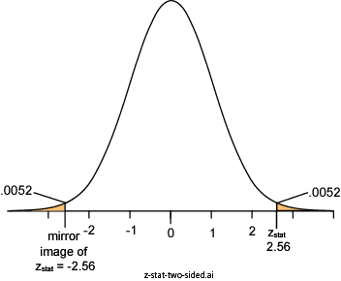
Two-Sided P-value: Lake Wobegon
H_{a}: µ ≠100
Considers random deviations “up” and “down” from μ₀ ⇒tails above and below ±z_{stat}
Thus, two-sided P = 2 × 0.0052 = 0.0104

Slide 31
Power and Sample Size
Two types of decision errors:
Type I error = erroneous rejection of true H₀
Type II error = erroneous retention of false H₀
 | Truth
Decision | H₀ true | H₀ false
Retain H₀ | Correct retention | Type II error
Reject H₀ | Type I error | Correct rejection
α ≡ probability of a Type I error
β ≡ Probability of a Type II error

Slide 32
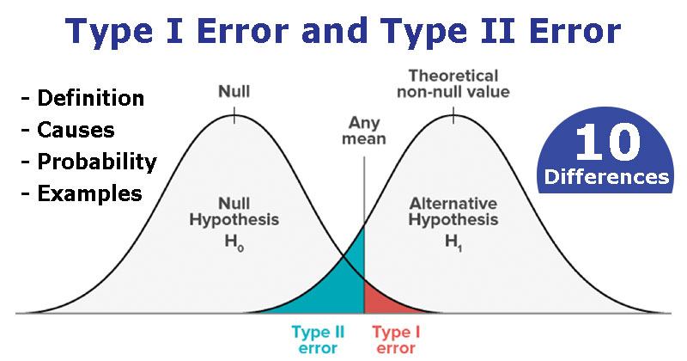

Slide 33
Power
β ≡ probability of a Type II error
β = Pr(retain H₀ | H₀ false) (the “|” is read as “given”)
1 – β = “Power” ≡ probability of avoiding a Type II error 1– β = Pr(reject H₀ | H₀ false)

Slide 34
Power of a z test
with
where
Φ(z) represent the cumulative probability of Standard Normal Z
μ₀ represent the population mean under the null hypothesis
μ_{a} represents the population mean under the alternative hypothesis
.

Slide 35
Calculating Power: Example
A study of n = 16 retains H₀: μ = 170 at α = 0.05 (two-sided); σ is 40. What was the power of test’s conditions to identify a population mean of 190?

Slide 36
Reasoning Behind Power
Competing sampling distributions
Top curve (next page) assumes H₀ is true
Bottom curve assumes H_{a} is true
α is set to 0.05 (two-sided)
We will reject H₀ when a sample mean exceeds 189.6 (right tail, top curve)
The probability of getting a value greater than 189.6 on the bottom curve is 0.5160, corresponding to the power of the test

Slide 37
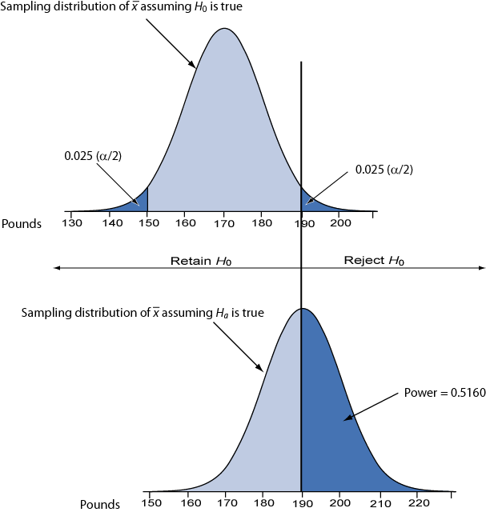

Slide 38
Sample Size Requirements
Sample size for one-sample z test:
where
1 – β ≡ desired power
α ≡ desired significance level (two-sided)
σ ≡ population standard deviation
Δ = μ₀ – μ_{a} ≡ the difference worth detecting

Slide 39
Example: Sample Size Requirement
How large a sample is needed for a one-sample z test with 90% power and α = 0.05 (two-tailed) when σ = 40? Let H₀: μ = 170 and H_{a}: μ = 190 (thus, Δ = μ₀ − μ_{a} = 170 – 190 = −20)
Round up to 42 to ensure adequate power.

Slide 40
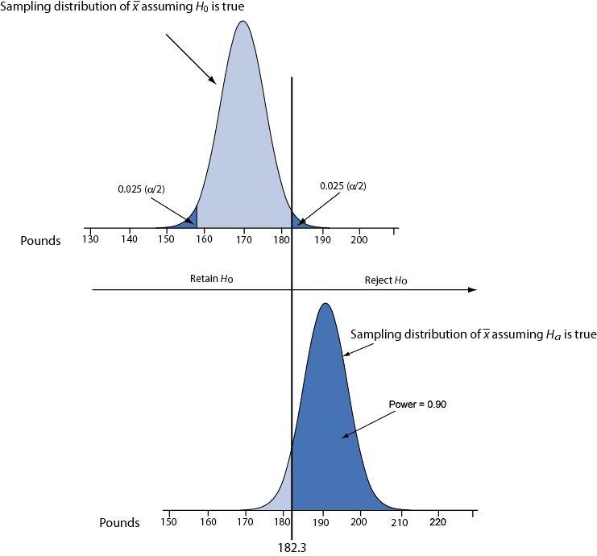
Illustration: conditions for 90% power.

Slide 41
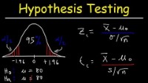
Additional Resources
https://www.simplilearn.com/tutorials/statistics-tutorial/hypothesis-testing-in-statistics
https://www.youtube.com/watch?v=zJ8e_wAWUzE&t=191s

Slide 42
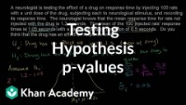
https://www.youtube.com/watch?v=-FtlH4svqx4

Slide 43
Inference about mean:
Estimated Standard Error of the Mean
Student’s t Distribution
One-Sample t Test
Confidence Interval for μ
Paired Samples
Conditions for Inference
Sample Size and Power

Slide 44
sigma not known
Prior chapter: σ was known before collecting data ⇒ z procedures used to help infer µ
When σ NOT known, calculate sample standard deviations s and use it to calculate this standard error:

Slide 45
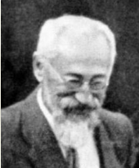
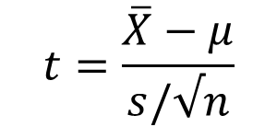
Additional Uncertainty
The Normal distribution doesn’t fit well
$$t=\frac{\overline{X}−μ}{s/√n}$$
Using s instead of σ adds uncertainty to inferences ⇒ can NOT use z procedures
Instead, rely on Student’s t procedures
William Sealy Gosset (1876–1937)

Slide 46
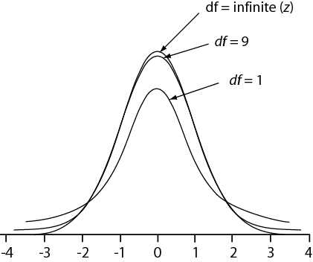
Student’s t distributions
Family of probability distributions
Family members identified by degrees of freedom (df)
Similar to “Z”, but with broader tails
As df increases → tails get skinnier → t become like z
A t distribution with infinite degrees of freedom is a Standard Normal Z distribution

Slide 47
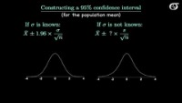
https://www.youtube.com/watch?v=Uv6nGIgZMVw&t=388s

Slide 48
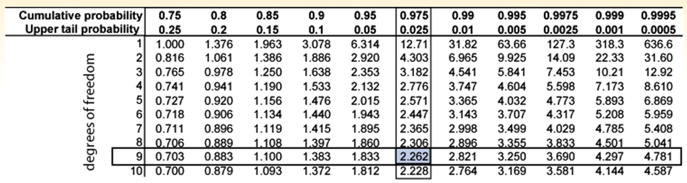
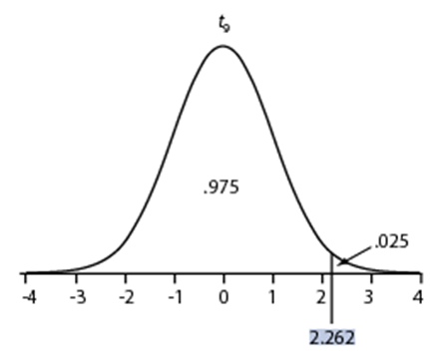
Table C (t table)
Rows ⇒ df
Columns ⇒ probabilities
Entries ⇒ t values
Notation: t_{cum_prob,df} = t value
Example: t_{.975, 9} = 2.262

Slide 49
One-Sample t Test
Objective: test a claim about population mean µ
Conditions :
Simple Random Sample
Normal population or “large sample”

Slide 50

Hypothesis Statements
Null hypothesis H₀: µ = µ₀
where µ₀ represents the pop. mean expected by the null hypothesis
Alternative hypotheses
H_{a}: µ < µ₀ (one-sided, left)
H_{a}: µ > µ₀ (one-sided, right)
H_{a}: µ ≠ µ₀ (two-sided)

Slide 51

Example
Do SIDS babies have lower average birth weights than a general population mean µ of 3300 gms?
H₀: µ = 3300
H_{a}: µ < 3300 (one-sided) or H_{a}: µ ≠ 3300 (two-sided)

Slide 52
One-Sample t Test Statistic
where
This t statistic has n – 1 degrees of freedom

Slide 53
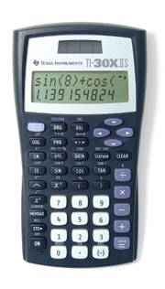
Example (Data)
SRS n = 10 birth weights (grams) of SIDS cases
2998
3740
2031
2804
2454
2780
2203
3803
3948
2144

Slide 54
Example
Testing H₀: µ = 3300

Slide 55
P-value via Table C
Bracket |t_{stat}| between t critical values
For |t_{stat}| = 1.80 with 9 df
|t_{stat}| = 1.80
Table C.
Upper-tail P | 0.25 | 0.20 | 0.15 | 0.10 | 0.05 | 0.025
df = 9 | 0.703 | 0.883 | 1.100 | 1.383 | 1.833 | 2.262
Thus ⇒ One-tailed: 0.05 < P < 0.10
Two-tailed: 0.10 < P < 0.20

Slide 56
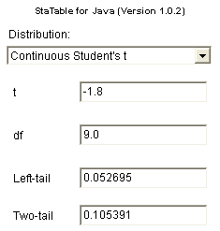
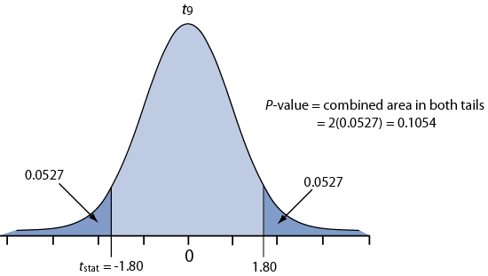
For a more precise P-value use a computer utility
Here’s output from the free utility StaTable
Graphically:

Slide 57

Interpretation
Testing H₀: µ = 3300 gms
Two-tailed P > .10
Conclude: weak evidence against H₀
The sample mean (2890.5) is NOT significantly different from 3300

Slide 58
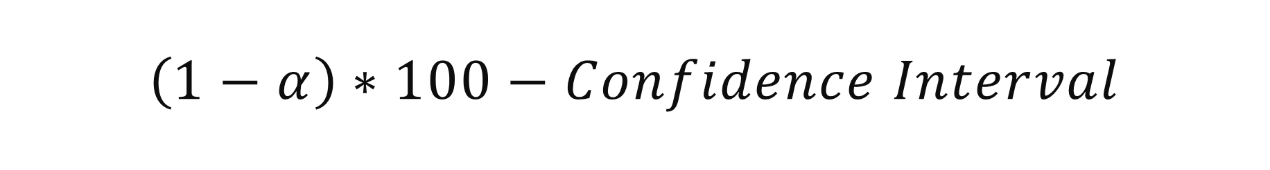
$$\left(1−α\right)∗100−Confidence Interval$$
where
From table

Slide 59
Same Data
Interpretation: Population mean µ is between 2375 and 3406 grams with 95% confidence

Slide 60
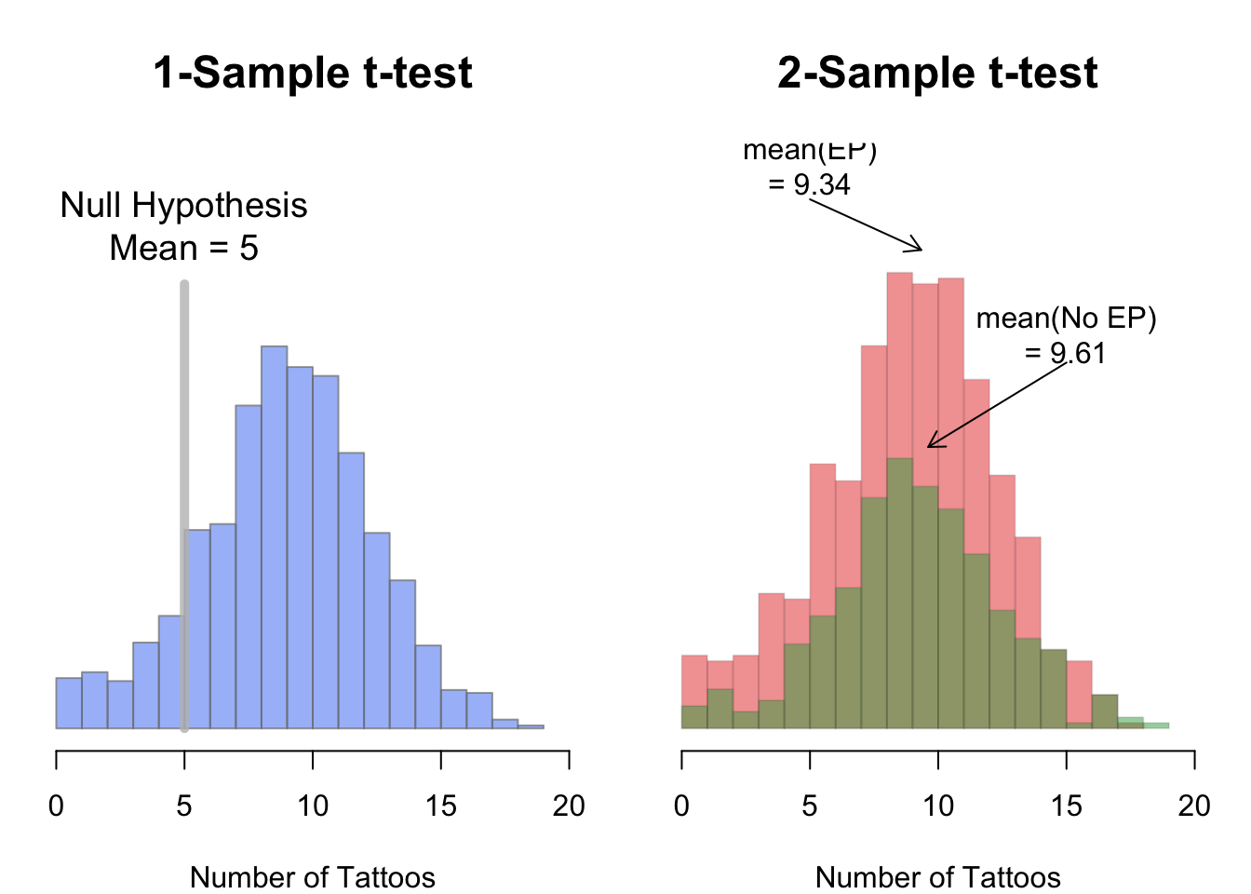
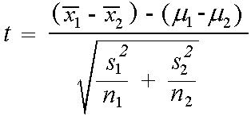

Two sample t test (Group difference)
Unequal variance
$$df=n_{1}+n_{2}−2$$

Slide 61
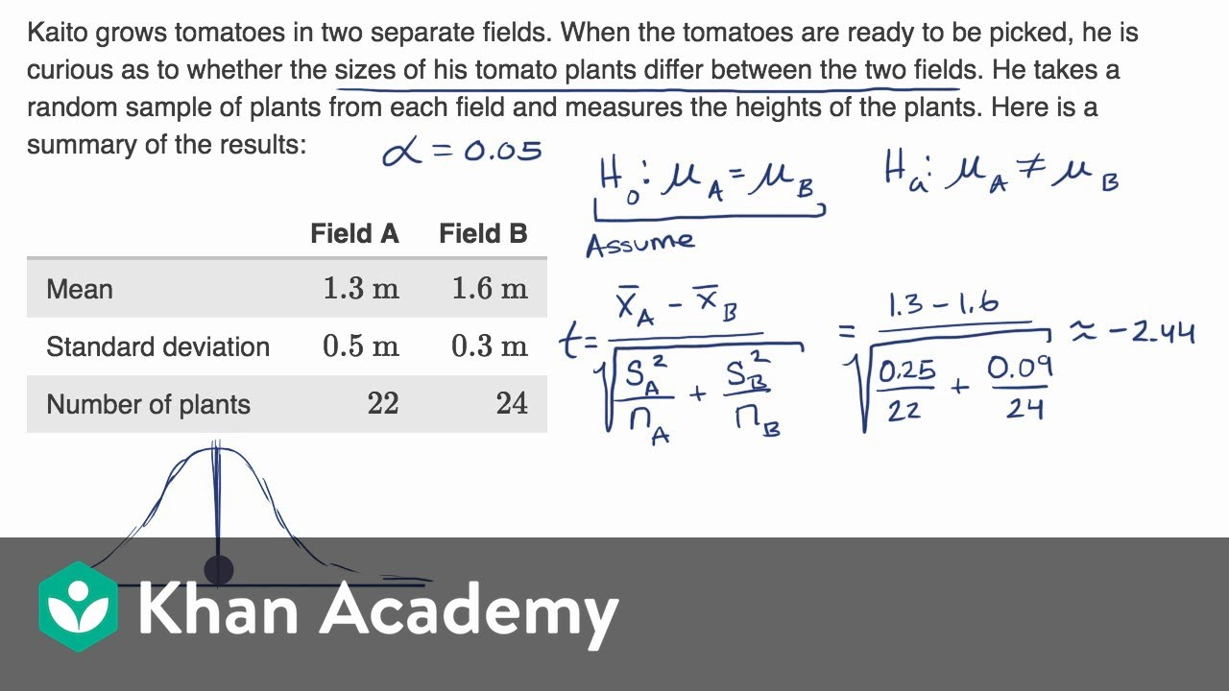
https://www.youtube.com/watch?v=NkGvw18zlGQ

Slide 62
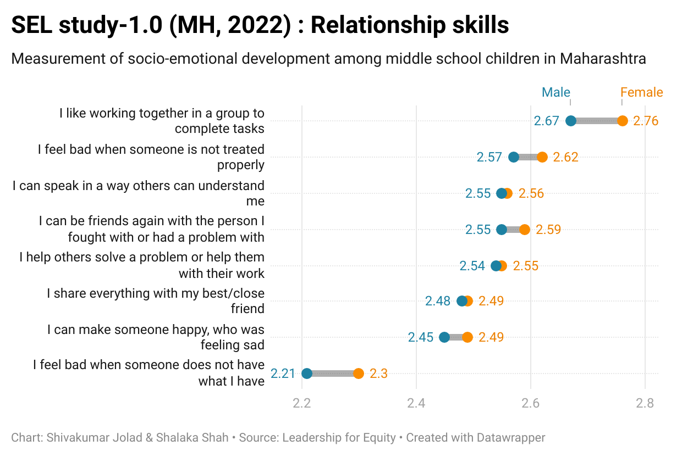
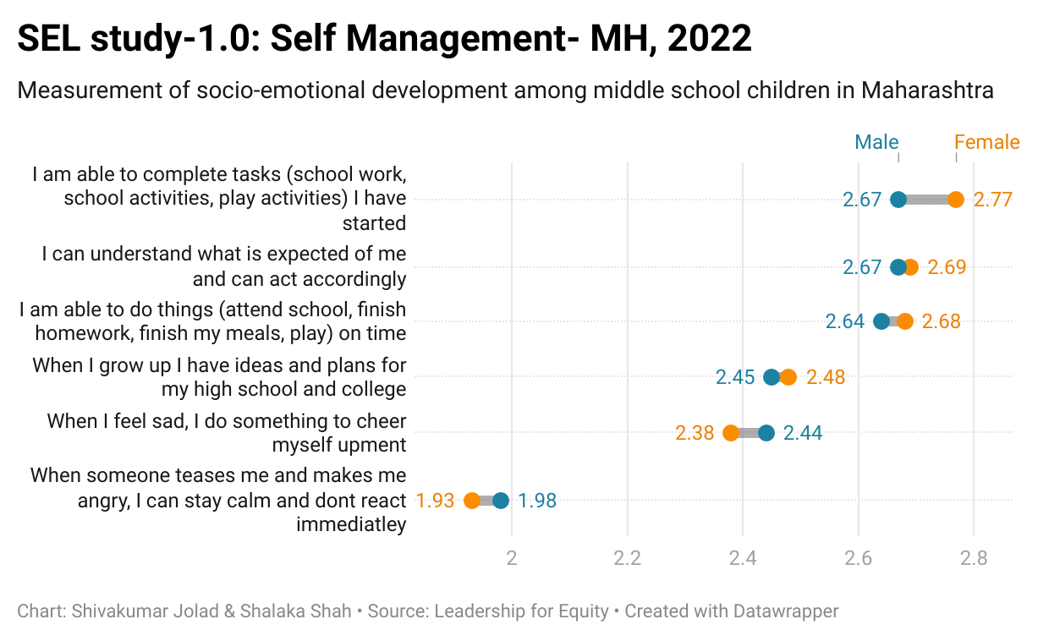
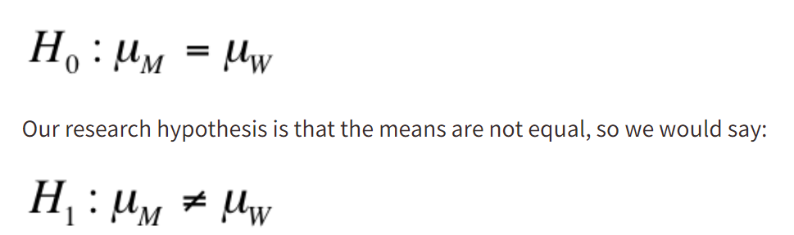

Slide 63
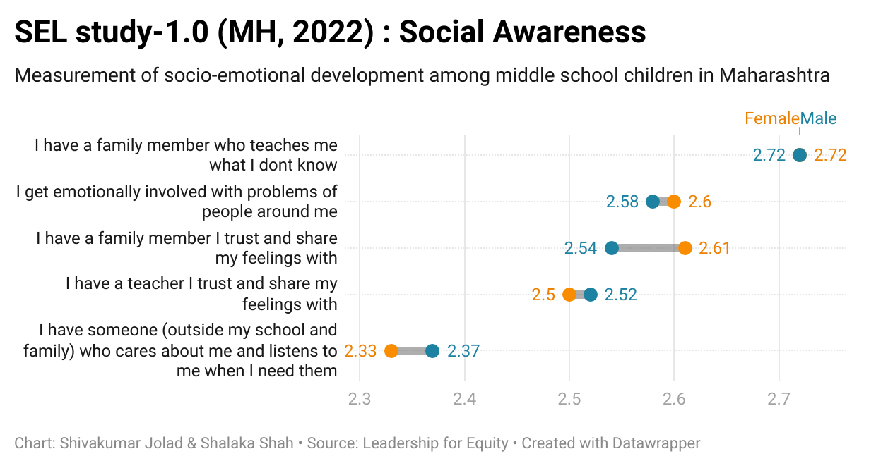
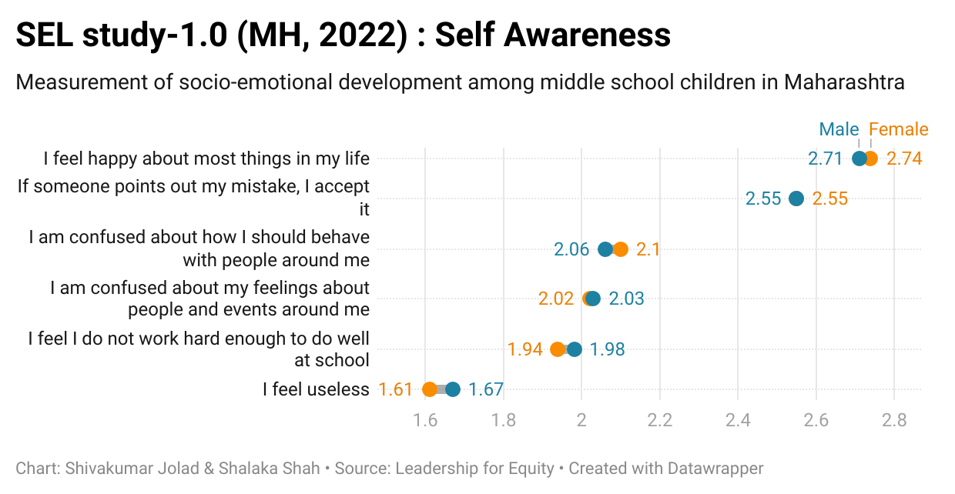

Slide 64
